Slide 1
超越学科界限的认知基础 Transdisciplinary Cognitive Foundation Week 1 A Foundation Grounded on Encoded Symmetries
Ben Koo
September 15, 2021

Slide 2
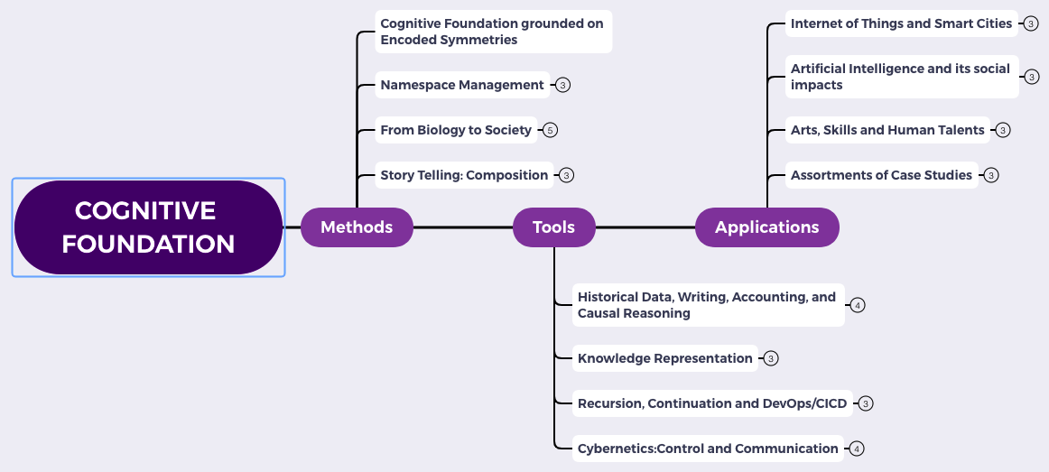
Content Themes for the semester
Overview
Namespace Management
Biology, Physics, Math, Code is Law, and Society
Story Telling, Functions/Metaphors/Analogies
Writing, Accounting, Historical Data and Temporal Reasoning
Knowledge Representation in Wiki and Files
Recursion and Continuation (DevOps/CICD)
Midterm Reports by Students
Cybernetics (Control and Communication)
Smart City and Internet of Things
Artificial Intelligence and its Social Impacts
Arts/Skills/Human Talents in the Digital Era
Student proposed Application Topics
Rehearsal
Final Reports and Celebration

Slide 3
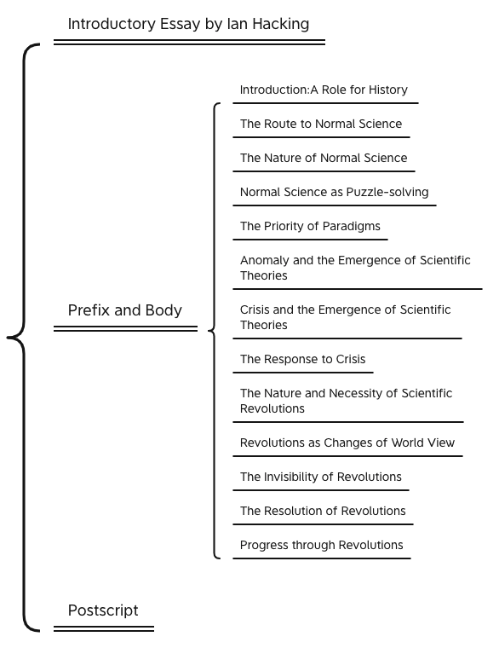
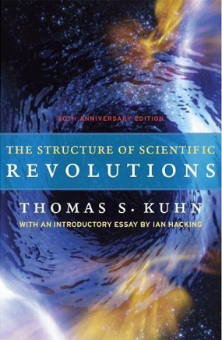
A classic that paved the road for many

Slide 4
Why did the book started with History?
What sciences were mentioned?
Who is Ian Hacking?

Slide 5
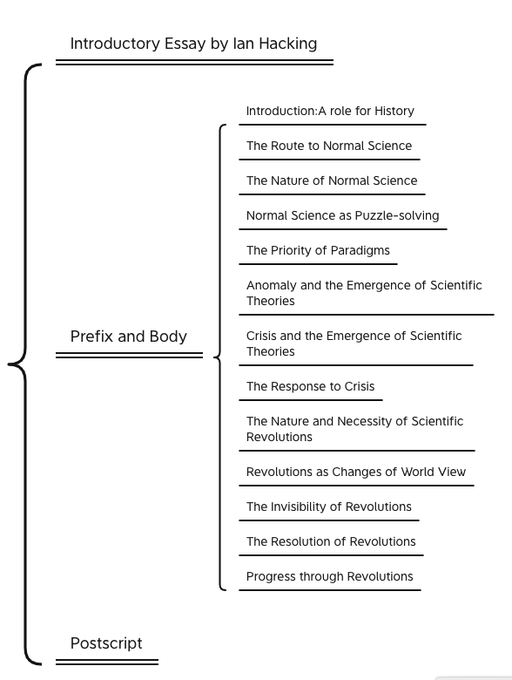
Key Ideas in Kuhn’s Dictionary
Incommensurable
不可通约的
Anomoly
Pre-Science
Normal Science
Puzzle Solving
Model Crisis
Model Revolution
Paradigm Change
Original Diagram from: https://www.thwink.org/sustain/glossary/KuhnCycle.htm

Slide 6

Kuhn Cycle in the Big Data-AI Era
Normal Operations
Drifting Norms
Operational Crisis
User Revolution
Version Upgrade
Emerging cases or
systematic attacks

Slide 7
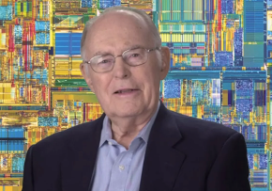
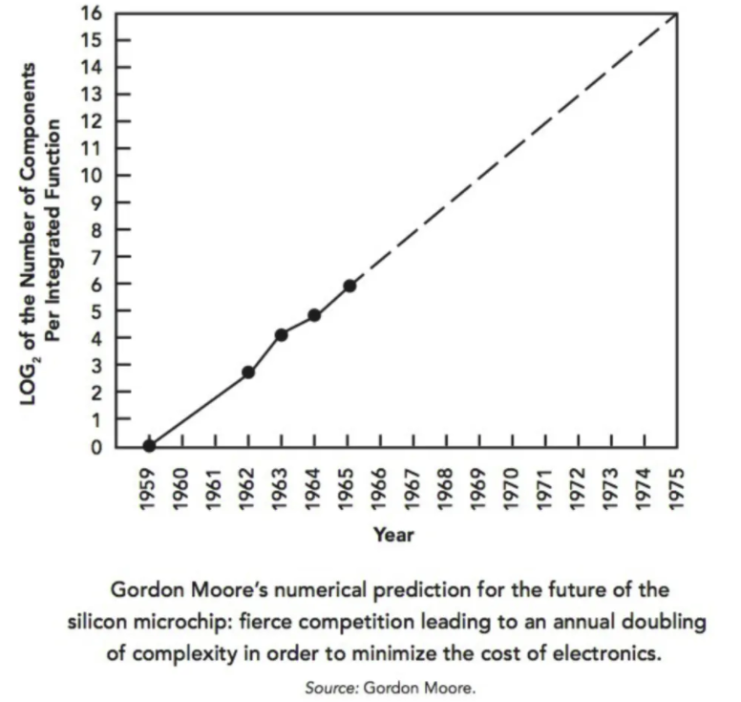

The Secret of Information Asymmetry
Before Moore, Data was dimensionless...
Space
What these top billionaires have in common that everyone else does not know.
by Vivek Sakpal May 19, 2018
Time
Moore provided the measurable strategy for executives that connected from socio-economic systems to quantum physics, and data sciences...
Moore’s Law is a sound Roadmap that associates physical dimensions with Data.
Notes:
How Startups from silicon valley disrupted the F500 with exponential growth
WHY did they succeed: Because they rely on a new paradigm which is moores law

Slide 8
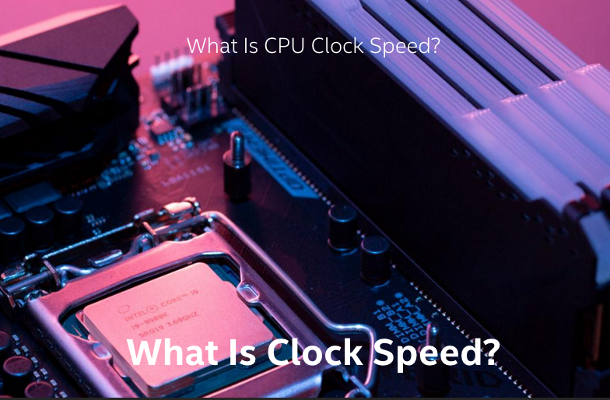
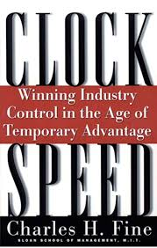

Societal Clockspeed determines how People Think

Slide 9
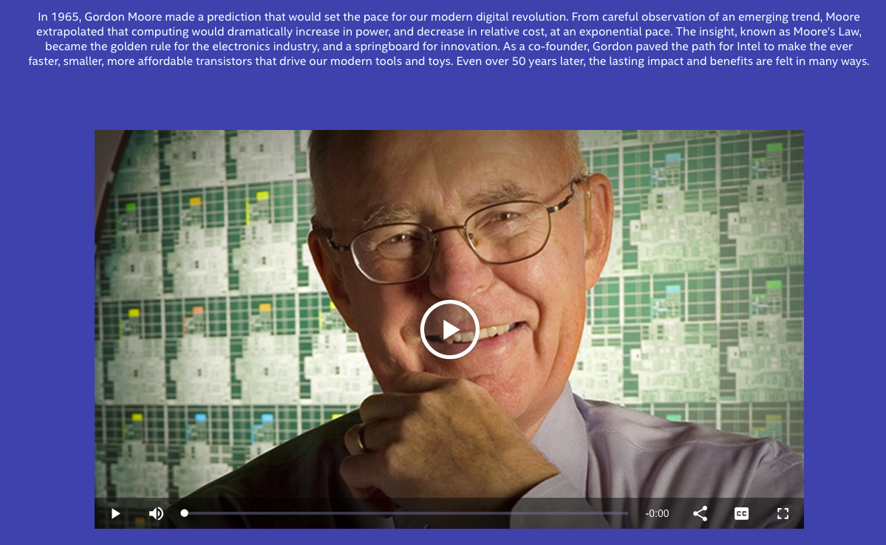
Intel’s Website Dedicated to Moore’s Law
50 th Anniversary of Moore’s Law
Hyperlink: https://www.intel.com/content/www/us/en/silicon-innovations/moores-law-technology.html

Slide 10
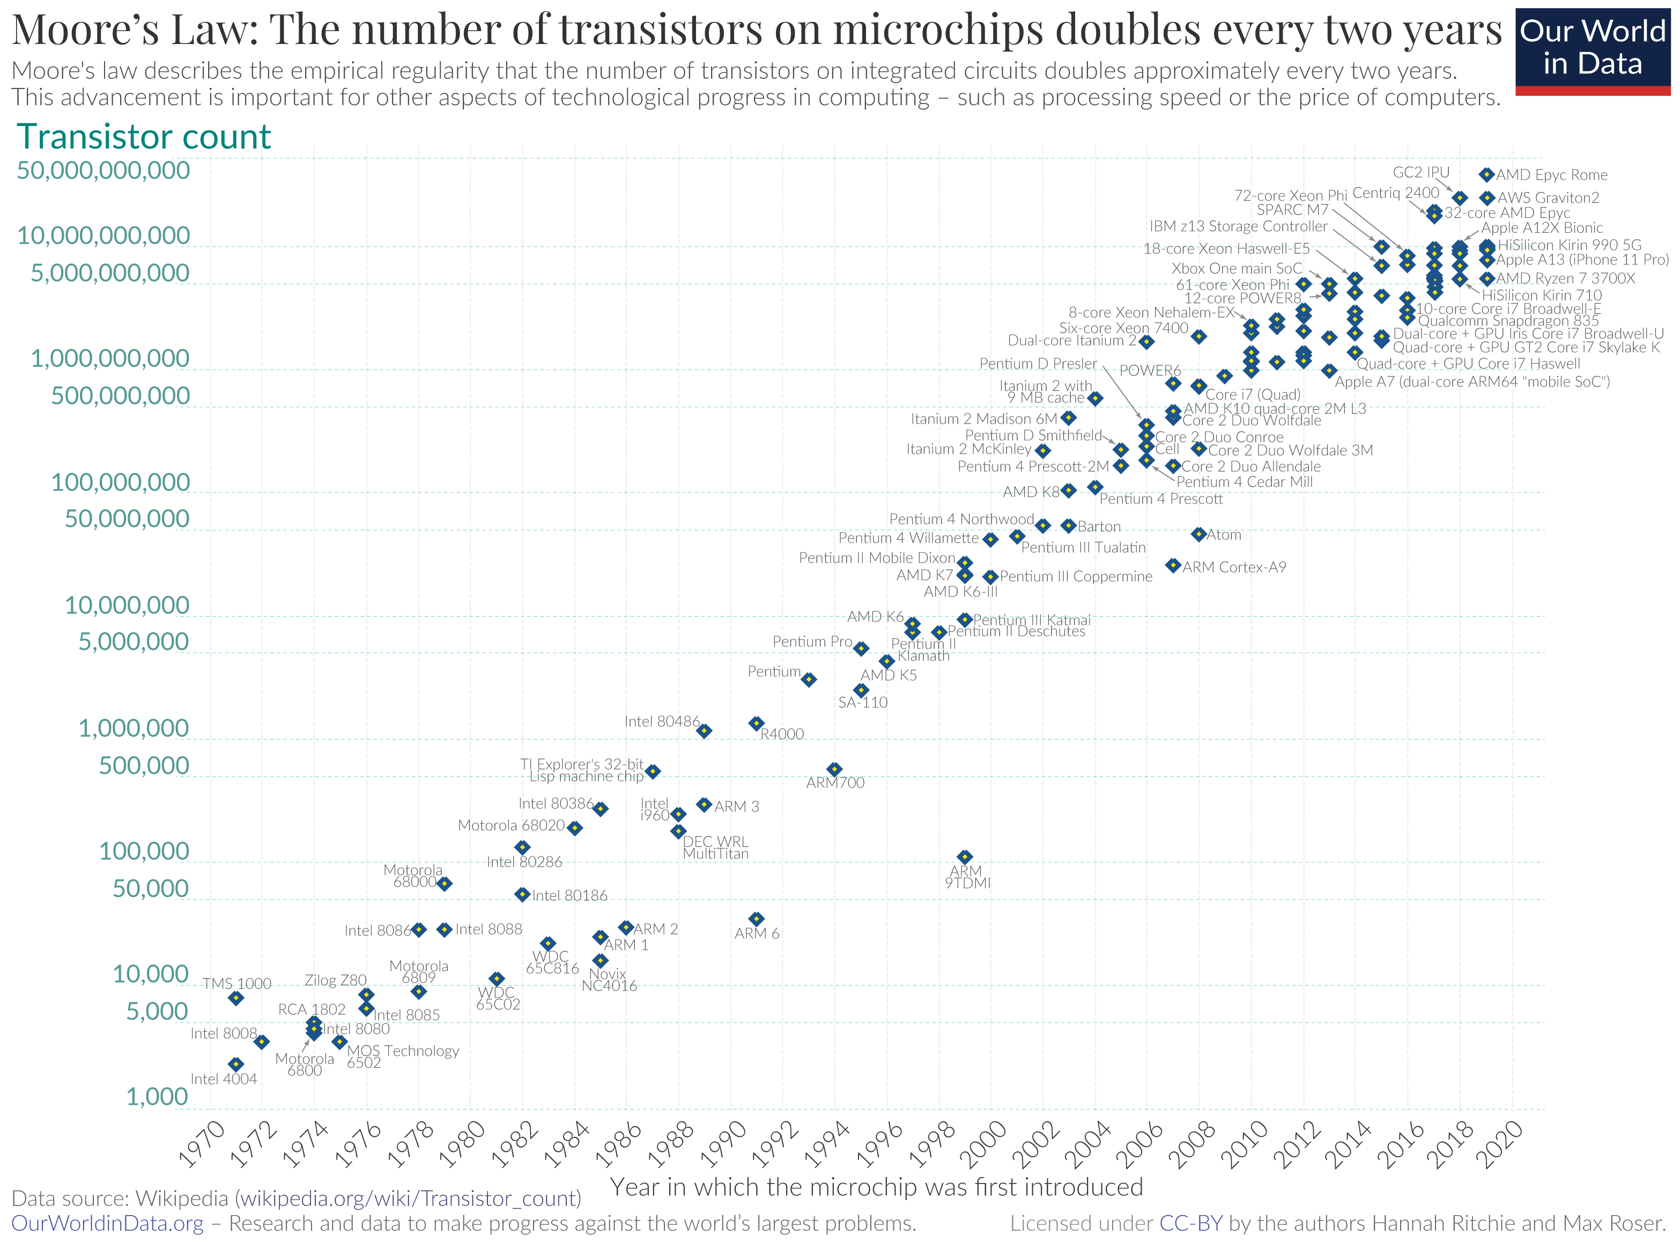

Moore’s Law as a symmetry in Innovation
”Just remember, whatever has been done, can be out done!”
Gordon Moore
Exponential Growth is a kind of Invariant
Image Source: Wikipedia
Notes:
Organise data to enable Security, Processing, Deployment
(notes) tensor flow logo??
Companies are using cloud services to gain access to tools that will hopefully improve their efficiency and ability to profit from Data; however, most companies do not have proper Namespace Management (NsM) so therefore the current methods of managing Data Assets, are complex, costly, and most importantly causing data to be a liability and not an asset.

Slide 11
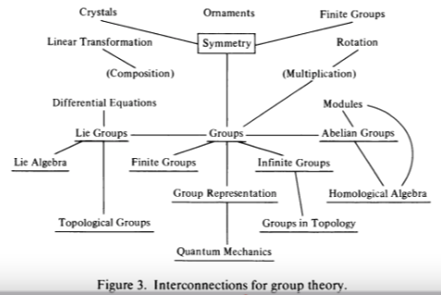
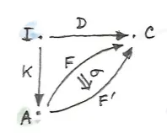
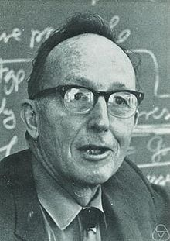
Symmetry/Invariance and Representable Closure
All concepts are Kan Extensions!
Kan Extensions Diagram
by Milewski
Page 425 of Mathematics: Form and Function by Saunders MacLane
Notes:
Organise data to enable Security, Processing, Deployment
(notes) tensor flow logo??
Companies are using cloud services to gain access to tools that will hopefully improve their efficiency and ability to profit from Data; however, most companies do not have proper Namespace Management (NsM) so therefore the current methods of managing Data Assets, are complex, costly, and most importantly causing data to be a liability and not an asset.

Slide 12

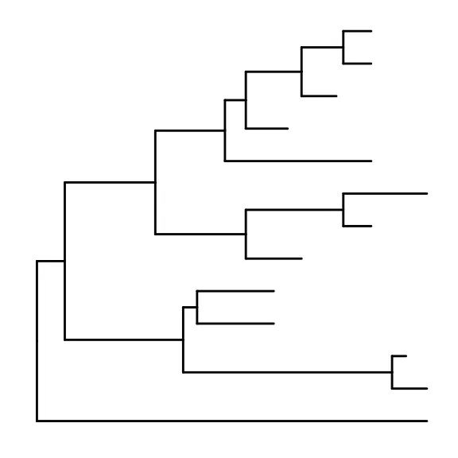

Data : Relations in Spacetime
Time
Data 2
Data 3
Data 1
Data: a discrete piece of evidence that proposes or breaks information symmetry based on previously available data.
Scott’s first axiom:
A data type is a partially ordered set (Poset).
Excerpt from: Outline of a Mathematical Theory of Computation
Space
Data 0
(Encoding Standards: all data can be encoded as Poset.)

Slide 13

The Soundness of Causal Data in Physical Space
Future
Present
Moment
Image Source: Wikipedia on light cone
Past
Private Space
Public Space
Public
Space
Spaces of Influences

Slide 14








A Roadmap for navigating Data in Spacetime
Future
Deployment
Present
Processing
Past
Public
Private
Public
Space of Data Privacy

Slide 15
The Science of Data Governance
Operating System: a platform for data processing
Notes:
(notes)
Make sure that they understand that working with the three challenge projects is to show them that all these principles exist in these organizations. We change the way they view the world so they can solve problems in their own environments
Page services files
Dev Sec Ops
Tools
Work flow

Slide 16
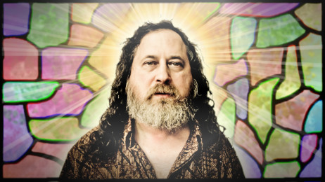
The One Hacker that Governed most of our Data
Richard Stallman
Founder of Free Software Foundation
Creator of GNU/Linux

Slide 17
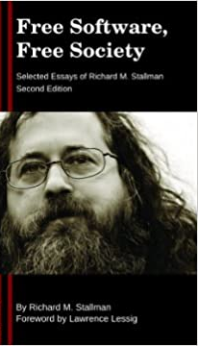

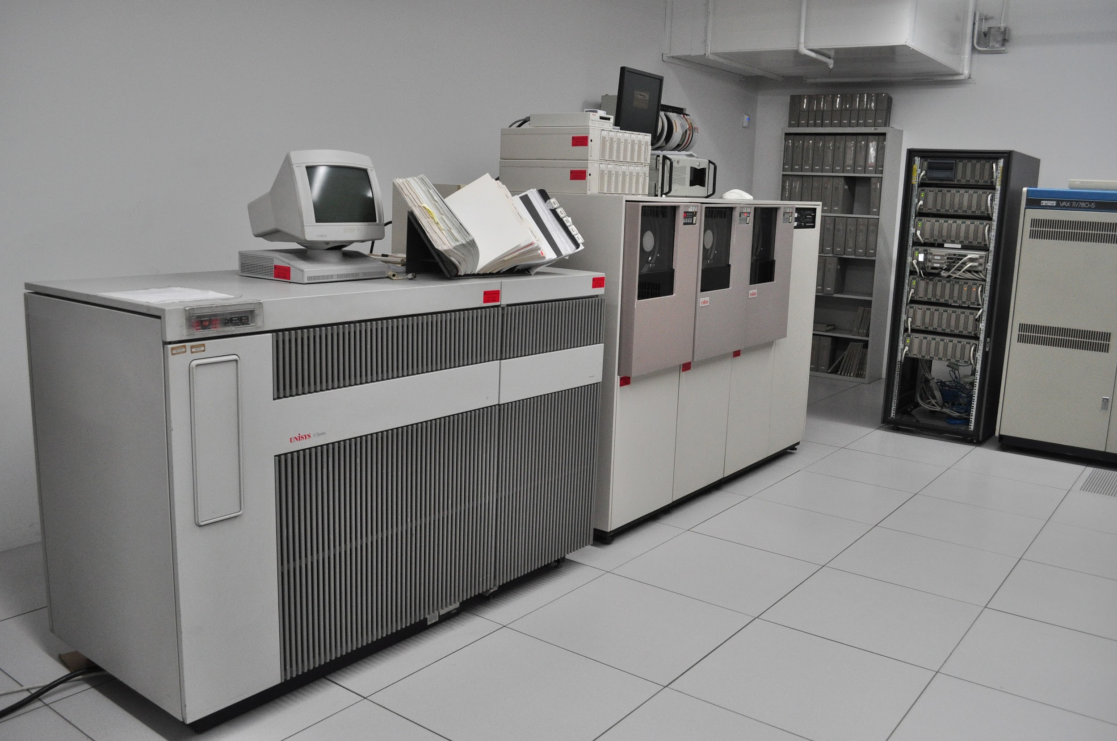
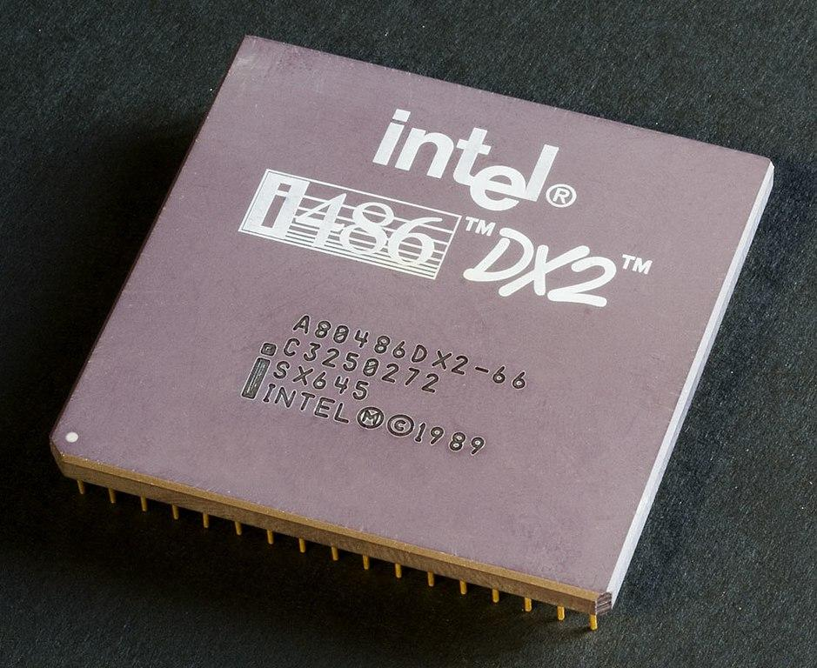
Free Software Operating System
Notes:
(notes) graphics???

Slide 18
The Contractual Closure on Data Governance
Open Source
Right to use published source code
Right to study published source code
Free Software
Freedom to modify published source code
Freedom to distribute modified software

Slide 19

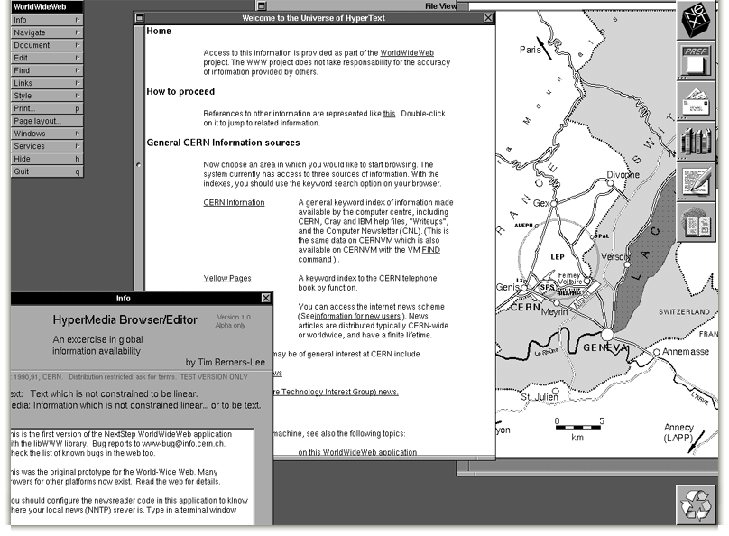
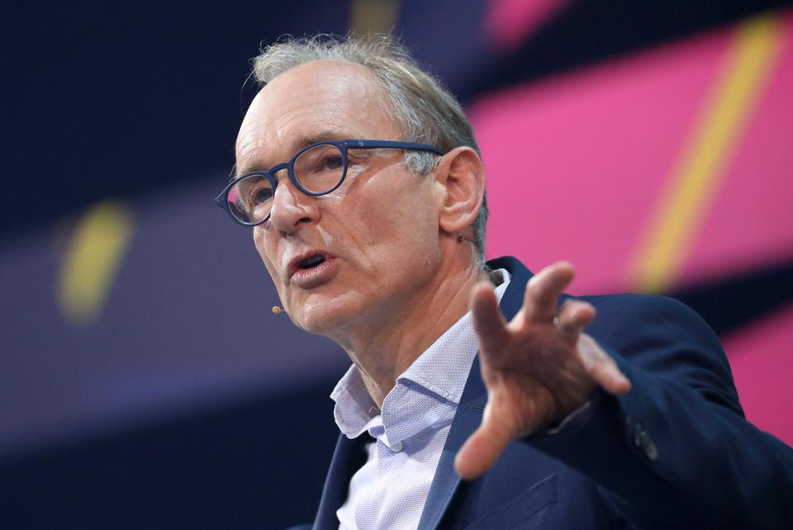


Namespace Management on the Global Scale
Berners-Lee called his vision for the web “utopian.”
He wanted it to be a place where all people had access to the best information at any time.

Slide 20
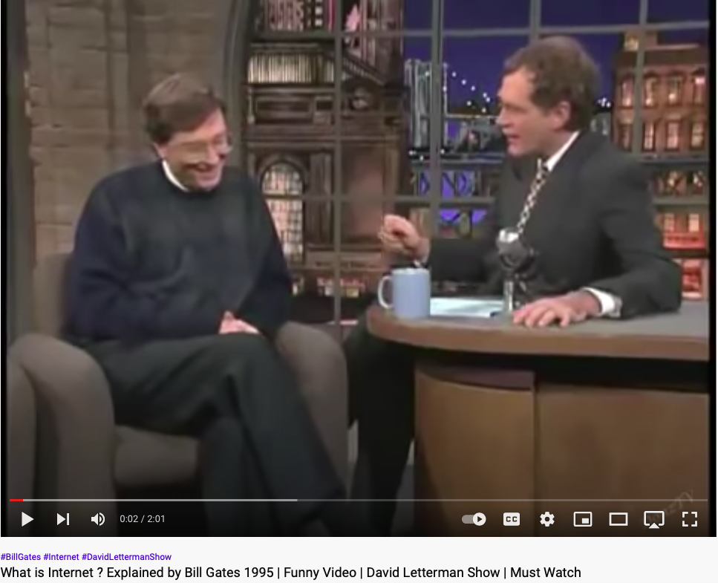
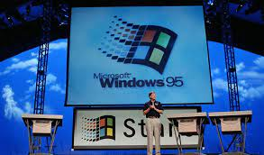
Incommensurable Ideas: What is Internet?
Notes:
(notes) graphics???

Slide 21




Browsers are the new operating systems
open-source
closed-source
Microsoft Edge
Chromium
open-source
closed-source
Brave
Google Chrome
Notes:
Wasm adds new capabilities for browsers as operating systems

Slide 22



The Universal Component for Data Organisation
Key
Hyperlink
Value
why directed link is a form of universal data abstraction

Slide 23
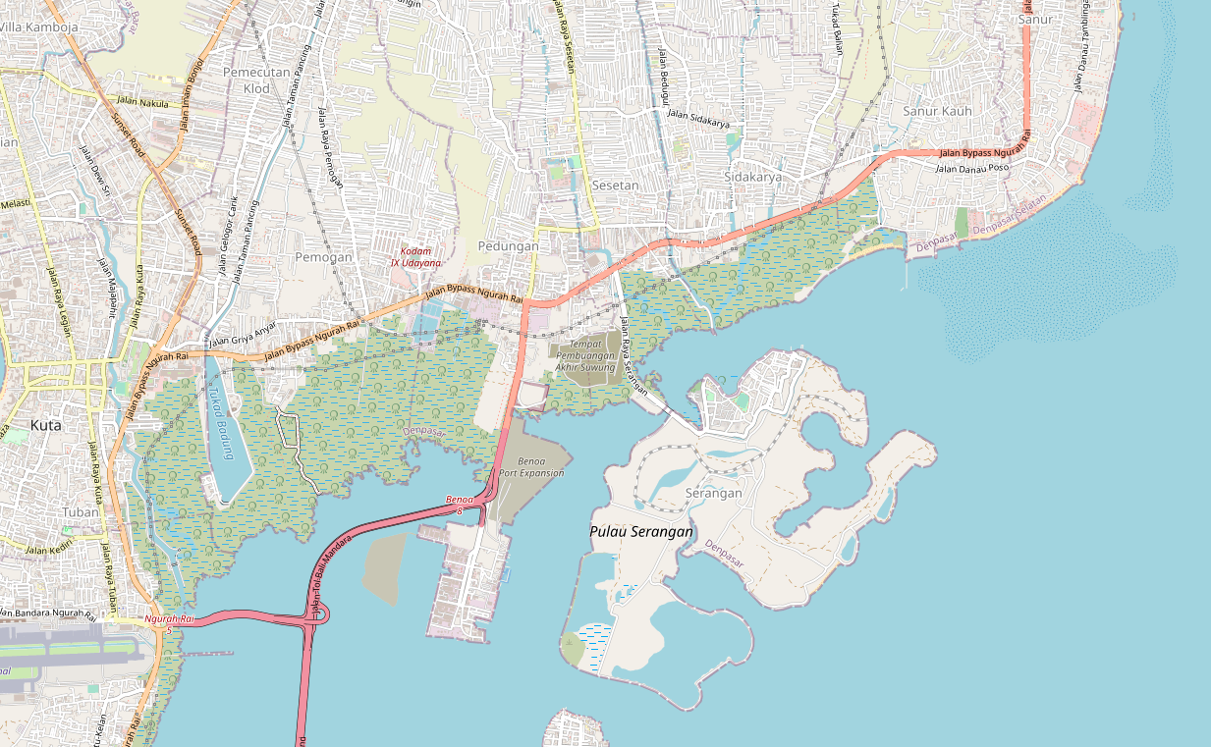
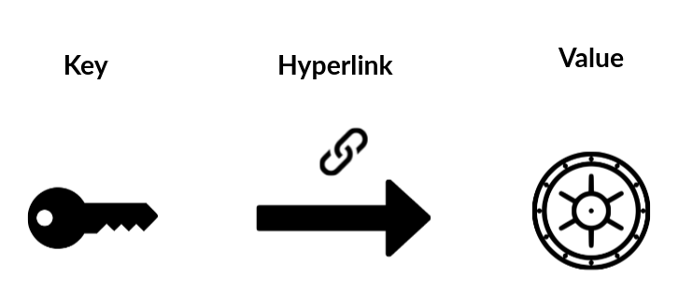
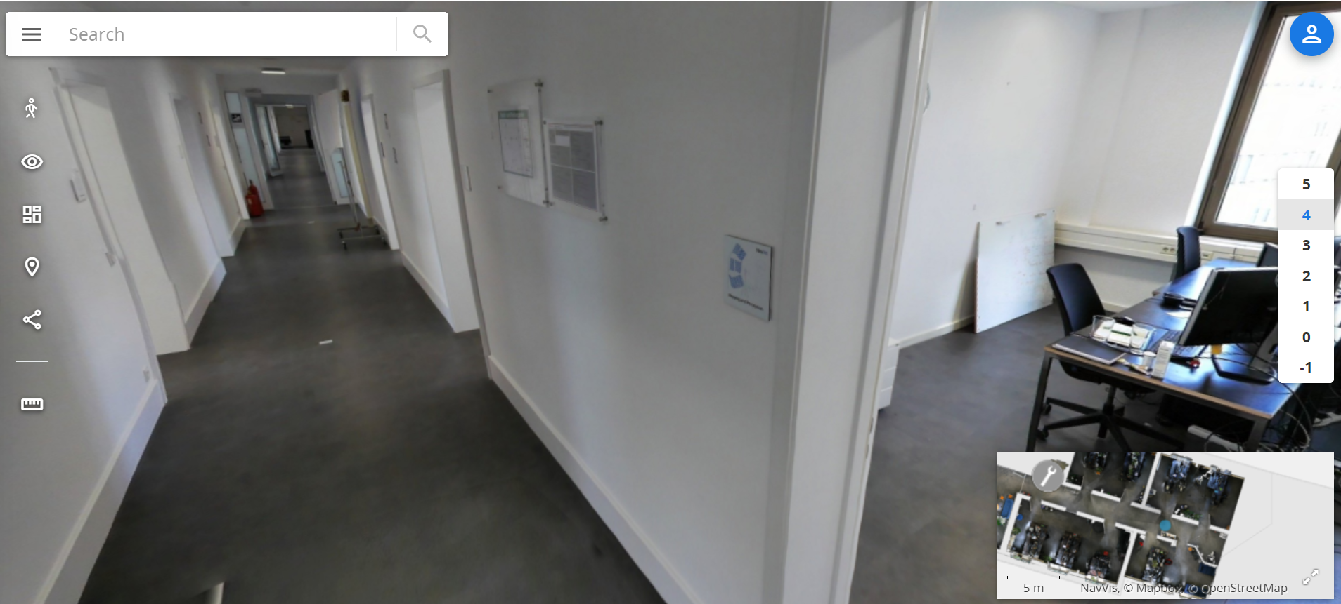
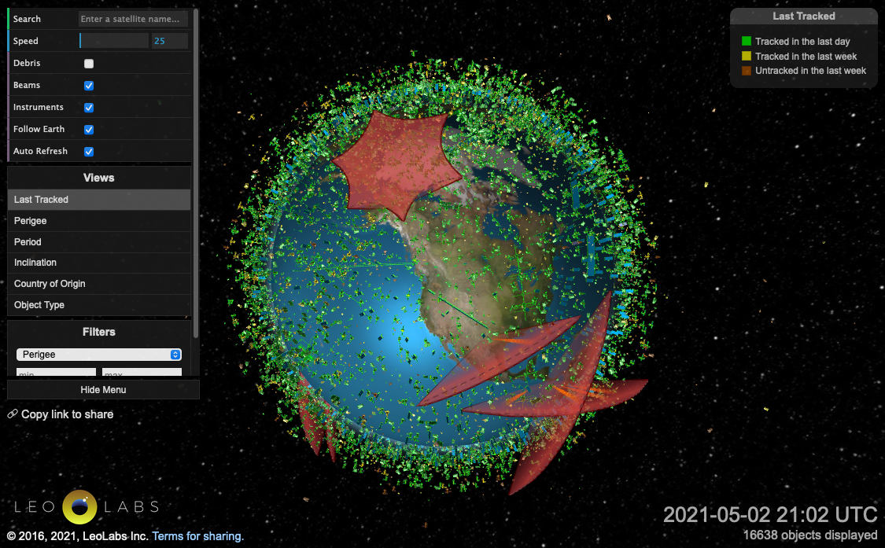
Data Organized as Multi-Dimensional Maps
Notes:
defined naming convention with defined name spaces
1 D map - hyperlink
2 D map - google maps
3 D map - jumping between multi-layer maps (VR Map in building)
4 D map - 3d Satellite map with time where we can go back and forth in time

Slide 24



Data Processing
Input
Algorithm
Output
All algorithms are representable as functions

Slide 25


Data Deployment
Plan
Execution
Desirable Resource
Allocation
Actual Resource Allocation
All computing services can be managed as named resources
Extra Reading: SoA and the Bezos Mandate
a data serialization
standard for all computing services
Notes:
Open Sourced Tools like Kubernetes, continuously compares Actual Resource Allocation/Availability against the Desired Resource Allocation Specification

Slide 26




Types of Data
File
Page
Service
Data Governance (Namespaces)

Slide 27



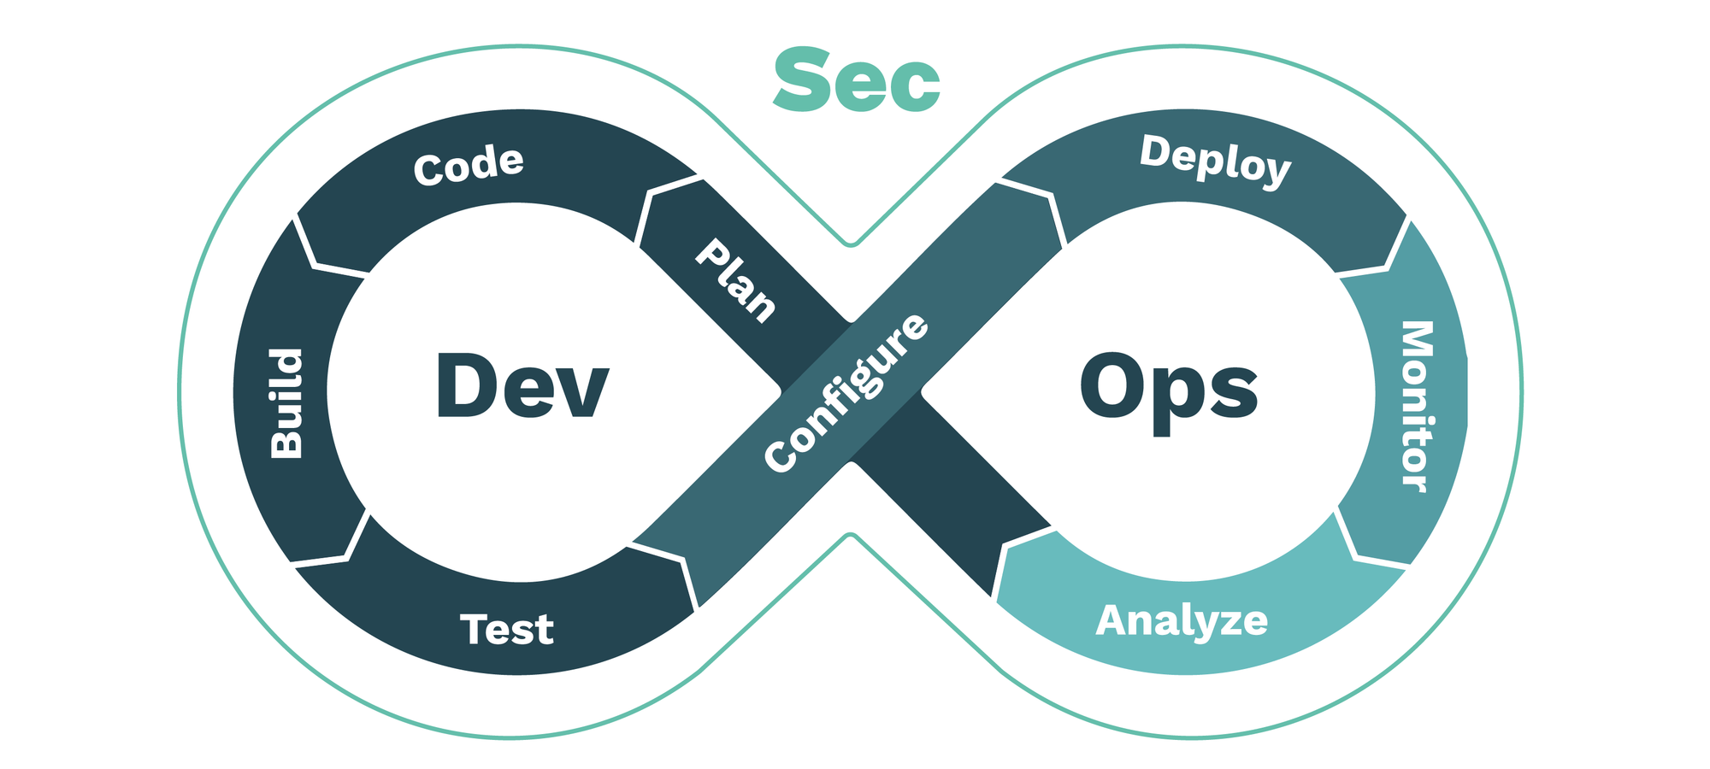
An Operating System on Networked Data
Data
that are legitimate to collect and fit everywhere
Page
Service
Validate
Browsers
Algorithms
that Correctly Synchronizes Data Content
Compute Power
to be cheaply replicated for fault tolerance
Develop
Deploy
File

Slide 28
Universal Data Abstraction
Cognitive Effectiveness can be enhanced by
a Unifying Data Abstraction

Slide 29
Key-Value Data Type is a Universal Abstraction
Mapped Domains | key/value | Examples
data/data | Inputs/Outputs | Dictionary/Tabulated Data
structure/structure | algorithm/source code | Logical Structures/Functions in Software Libraries
language/language | Specification/Implementation | Source Code/Executable Binary
Notes:
Soundness (Aliveness vs Safety = Correctness)
Precision (The result has a outer boundary)
Termination (It will come to completion)

Slide 30
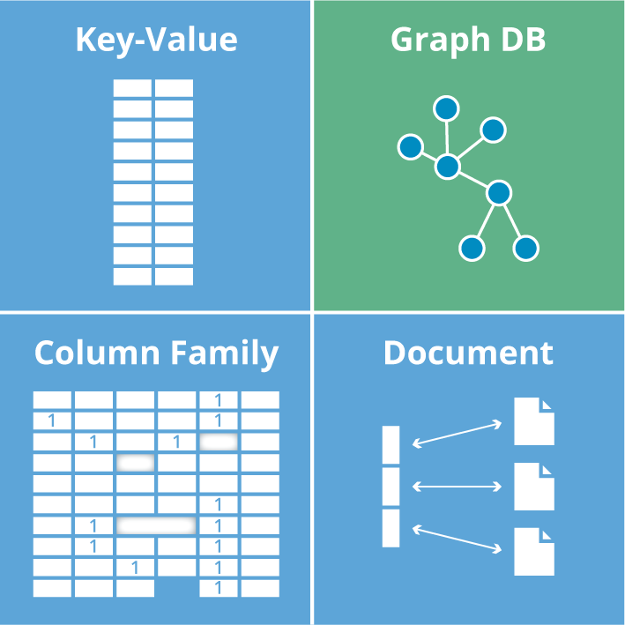
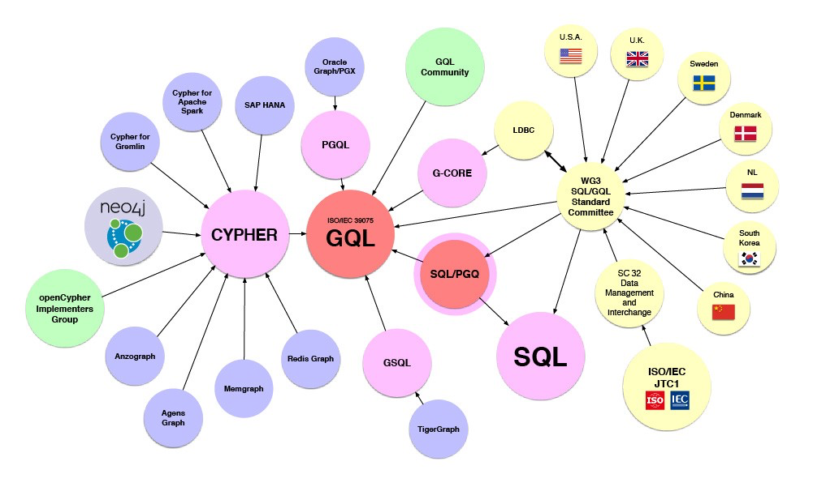






Encoded Symmetries in the IT industry
Image source: Graph Database for Beginners by Neo4j

Slide 31
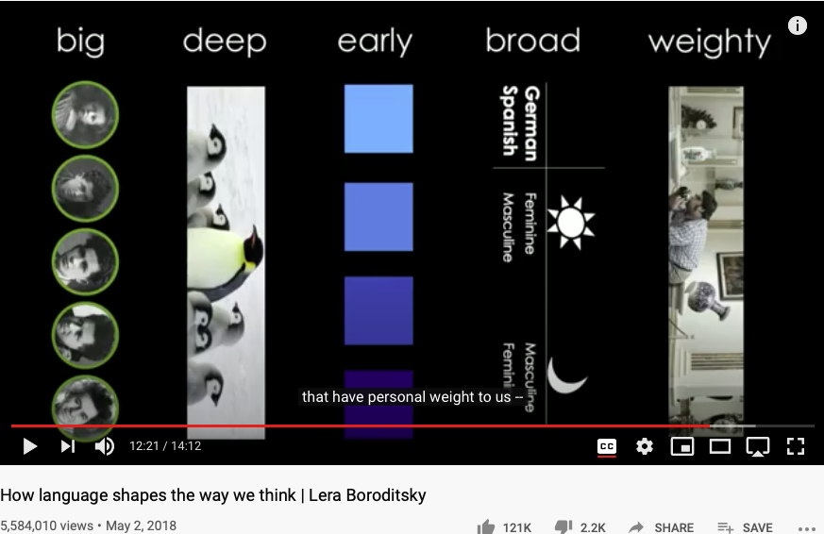
Language as a Cognitive Device
Huawei VP Mr. Yang Shaoqing
https://youtu.be/RKK7wGAYP6k

Slide 32
How does it relate to the book?
Pre-Science
Normal Science
Model
Drift
Model Crisis
Model Revolution
Paradigm Change

Slide 33
Key Ideas in Kuhn’s Dictionary
Incommensurable
不可通约的
Anomoly
Pre-Science
Normal Science
Model
Drift
Model Crisis
Model Revolution
Paradigm Change
Original Diagram from: https://www.thwink.org/sustain/glossary/KuhnCycle.htm

Slide 34
Key Concepts
Symmetries/Invariance, History/Time,
Data/Causal Relation/Key-Value/Dictionary,
Universal Data Abstraction

Slide 35
How are symmetries useful?
“Everything should be made as simple as possible,
but not simpler.”
Albert Einstein
Useful Data Abstraction:
A sound data practice that attains
precise,
yet terminable
Rrepresentation of Real World Events.

Slide 36



The Meta Vocabulary on “Cognitive” Models
Soundness
Precision
Termination
This is the meta glossary.
Notes:
(notes) add hyperlinks with definitions
Soundness: A Sound statement is a true statement whose composed sub-statements all accountably true, and the overall constructed statement also can be assessed to be true.
The degree of a statement to be sound is its Soundness assessment.
Precision (The result has a outer boundary)
Termination (It will come to completion)

Slide 37

Summary
Key-Value Pair (hyperlink) is a data structure that has universal expressiveness
Synonyms of Key-Value Pair:
Arrow, Function, Directed/Causal Relation, Map, Dictionary
Hyperlink provide a symmetry-breaking representational primitive, which can serve as the foundation of cognitive reasoning.
Encoded Symmetries are the cognitive keys in IT, AI, and Sciences.
Time-bound keys | Data Content Space (valuable assets) | Industrialized Tools
Past | Version-Controlled Files and Code | Git and Docker (data and source code)
Present | Dynamically Rendered Pages | Wiki (hyperlinked resources)
Future | Continuously Integrated, Delivered, and Deployed Services | Kubernetes/Nomad (service governance)

Slide 38
Content Outline for the semester
Cybernetics (Control and Communication)
Smart City and Internet of Things
Artificial Intelligence and its Social Impacts
Arts/Skills/Human Talents in the Digital Era
Student proposed Application Topics
Rehearsal
Final Reports and Celebration
A Cognitive Foundation grounded on Encoded Symmetries
Namespace Management
Biology, Physics, Math, Code is Law, and Society
Story Telling, Functions/Metaphors/Analogies
Writing, Accounting, Historical Data and Temporal Reasoning
Knowledge Representation in Wiki and Files
Recursion and Continuation (DevOps/CICD)
Midterm Reports by Students

Slide 39
References
Data Scott, Outline of a Mathematical Theory of Computation, Jan, 1977
Cousot & Cousot, Abstract Interpretation: A unified lattice model for static analysis of programs by construction or approximation of fixed points, Jan., 1977
Matt O’Dowd, The Geometry of Causality, PBS Space Time, last access: May 27, 2021, https://youtu.be/1YFrISfN7jo

